Slide 1

ggPMX Workshop PAGE 2019
Irina Baltcheva & Bruno Bieth
Satellite workshop at PAGE meeting 2019, Stockholm, Sweden
June 11, 2019

Slide 2


Irina Baltcheva
Pharmacometrics
Novartis Pharma AG
(8+ years experience)
Background: Applied Mathematics
Bruno Bieth
Pharmacometrics
Novartis Pharma AG
(10+ years experience)
Background: Applied Mathematics
ggPMX Team
Irina Baltcheva, Amine Gassem*, Christian Bartels, Thomas Dumortier, Souvik Bhattacharya Inga Ludwig, Ines Paule, Didier Renard, Bruno Bieth
*R developer

Slide 3
Agenda
Time | Topic
2:00 PM | Welcome and getting everyone started
2:15 PM | Lecture: Introduction to ggPMX – R package for Model Diagnostics Generation
3:30 PM | Coffee Break
3:45 PM | Hands-On / Demo
4:45 PM | Wrap-up / Q&A
5 PM | END

Slide 4
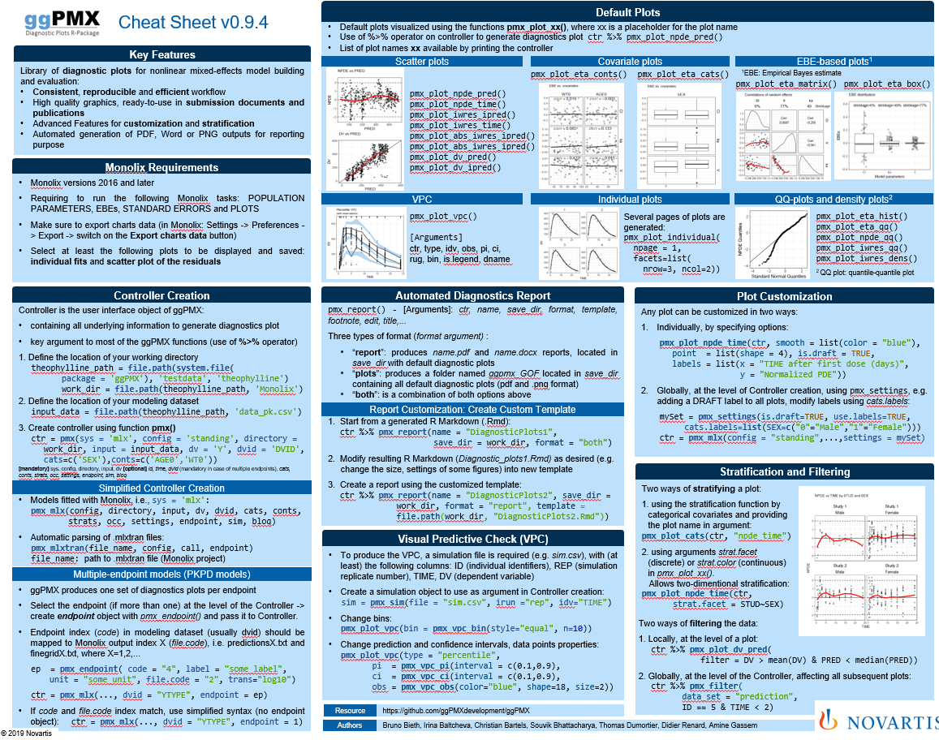
Cheat Sheet

Slide 5
Acronyms
BLQ | Below the limit of quantification
DV | Dependent variable
ETA | Inter-individual random effect
EBE | Empirical Bayes estimate
EPRED | Population prediction (expected)
IIV | Inter-individual variability
IPRED | Individual prediction
M&S | Modeling & Simulation
NLME | Nonlinear mixed-effects (model)
NPD | Normalized prediction discrepancy
NPDE | Normalized prediction distribution error
PD | Pharmacodynamics
PK | Pharmacokinetics
VPC | Visual predictive check

Slide 6
Overview
Introduction
Monolix requirements (tasks to perform)
Installation
Architecture
Built-in example and default plots
Report generation
Advanced Controller creation
Single endpoint models
Multiple endpoint models
Models with covariates
VPC (Visual Predictive Checks)
Plots customization
Stratification, filtering and other features
How to provide feedback?

Slide 7
ggPMX - R package for model diagnostics
Why
No standard tools to support evaluation of nonlinear mixed effect models within the Pharmacometrics (PMX) across different softwares (Monolix, NONMEM, nlmxir)
What
Develop R package to provide a comprehensive and ‘modern’ set of tool to facilitate efficient diagnostics and reporting of models across different softwares
Who
Pharmacometrics Community
Goal
Improve consistency, efficiency and quality in internal usage of model diagnostics, translating into improved modeling productivity and quality
Where
Available on CRAN & GitHub

Slide 8
ggPMX to generate default model diagnostics
Monolix
(2016, ...)
70%
gain
Modeling Workflow
Productivity
Internal Guidance for Model Diagnostics
100%
gain
NONMEM*
* Soon
~25%
Time to write codes for generating Diagnostic Plots
Standardization
100%
gain
nlmxir*
* Summer 2019
~10%
Enforce Good Practices
Time to validate codes generating Diagnostic Plots

Slide 9

Internal Guidance ggPMX built upon the Novartis Pharmacometrics Internal Guidance on Good Practices for model building, evaluation and qualification
12+
Diagnostic Plots
2+
Types of Outputs (Monolix, nlmixR, NONMEM) handled by ggPMX

Slide 10
List of Diagnostic Plots
Section of modeling report | Description | Novartis | HA
Main body | Plot of normalized prediction distribution errors versus population predictions (NPD vs. EPRED) | ✔ | ✔
 | Plot of normalized prediction discrepancies versus time (NPD vs. TIME) | ✔ | ✔
 | Plot of individual weighted residuals versus individual predictions (IWRES vs. IPRED) | ✔ | ✔
 | Plot of individual weighted residuals versus time (IWRES vs. TIME) | ✔ | ✔
 | Visual predictive check (VPC) | ✔ | ✔
Appendix | Distribution and quantile-quantile plot of IWRES | ✔ | ✔
 | Distribution and correlation structure of estimated inter-individual random effects (ETA) | ✔ | ✔
 | Relationships between estimated inter-individual random effects (ETA) and covariates | ✔ | ✔
 | Plots of observations and model predictions per individual | ✔ | ✔
 | Plot of observations versus population predictions (DV vs. EPRED) |  | ✔
 | Plot of observations versus individual predictions (DV vs. IPRED) |  | ✔
 | Plot of absolute individual weighted residuals versus individual predictions (|IWRES| vs. IPRED) |  | ✔

Slide 11
Residual-based diagnostics Normalized Prediction Discrepancies (NPD) plots - Direct evaluation of systematic deviations between model predictions and observations along a horizontal (zero) line
Section of modeling report | Description | Novartis | HA
Main body | Plot of normalized prediction distribution errors versus population predictions (NPD vs. EPRED) | ✔ | ✔
 | Plot of normalized prediction discrepancies versus time (NPD vs. TIME) | ✔ | ✔
 | Plot of individual weighted residuals versus individual predictions (IWRES vs. IPRED) | ✔ | ✔
 | Plot of individual weighted residuals versus time (IWRES vs. TIME) | ✔ | ✔
 | Visual predictive check (VPC) | ✔ | ✔
Appendix | Distribution and quantile-quantile plot of IWRES | ✔ | ✔
 | Distribution and correlation structure of estimated inter-individual random effects (ETA) | ✔ | ✔
 | Relationships between estimated inter-individual random effects (ETA) and covariates | ✔ | ✔
 | Plots of observations and model predictions per individual | ✔ | ✔
 | Plot of observations versus population predictions (DV vs. EPRED) |  | ✔
 | Plot of observations versus individual predictions (DV vs. IPRED) |  | ✔
 | Plot of absolute individual weighted residuals versus individual predictions (|IWRES| vs. IPRED) |  | ✔

Slide 12
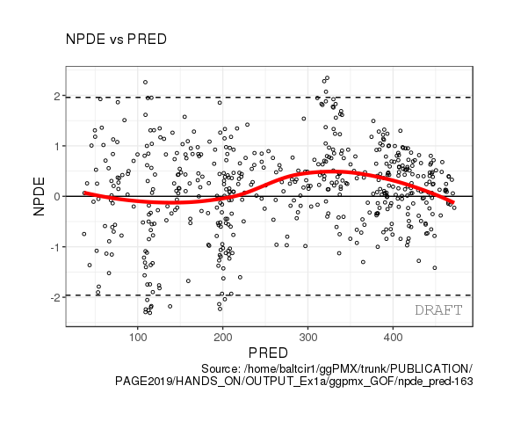
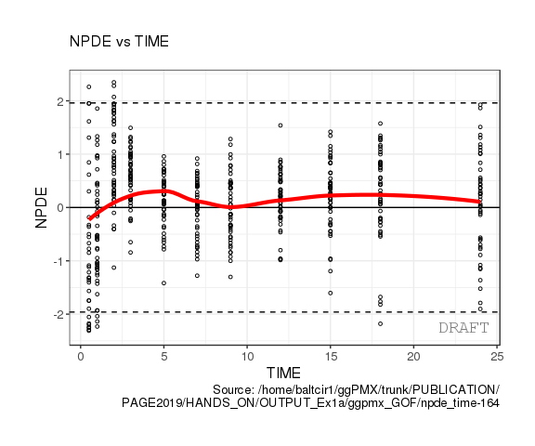
Residual-based diagnostics Normalized Prediction Discrepancies (NPD) plots - Direct evaluation of systematic deviations between model predictions and observations along a horizontal (zero) line

Slide 13
Residual-based diagnostics Individual Weighted Residual (IWRES)- inform about adequacy of individual predictions and correctness of the residual error model / check distributional assumptions
Section of modeling report | Description | Novartis | HA
Main body | Plot of normalized prediction distribution errors versus population predictions (NPD vs. EPRED) | ✔ | ✔
 | Plot of normalized prediction discrepancies versus time (NPD vs. TIME) | ✔ | ✔
 | Plot of individual weighted residuals versus individual predictions (IWRES vs. IPRED) | ✔ | ✔
 | Plot of individual weighted residuals versus time (IWRES vs. TIME) | ✔ | ✔
 | Visual predictive check (VPC) | ✔ | ✔
Appendix | Distribution and quantile-quantile plot of IWRES | ✔ | ✔
 | Distribution and correlation structure of estimated inter-individual random effects (ETA) | ✔ | ✔
 | Relationships between estimated inter-individual random effects (ETA) and covariates | ✔ | ✔
 | Plots of observations and model predictions per individual | ✔ | ✔
 | Plot of observations versus population predictions (DV vs. EPRED) |  | ✔
 | Plot of observations versus individual predictions (DV vs. IPRED) |  | ✔
 | Plot of absolute individual weighted residuals versus individual predictions (|IWRES| vs. IPRED) |  | ✔

Slide 14
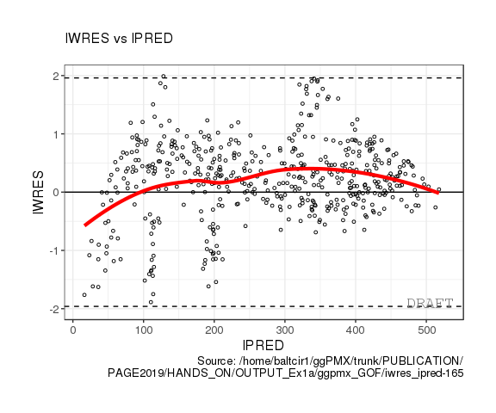
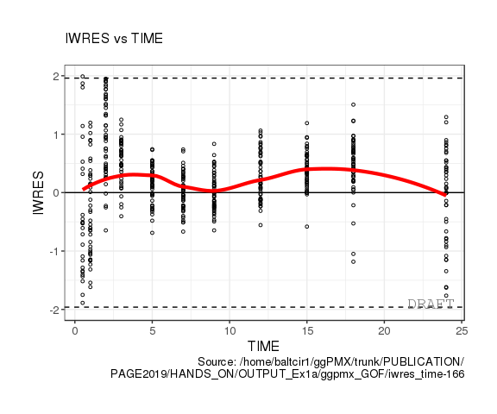
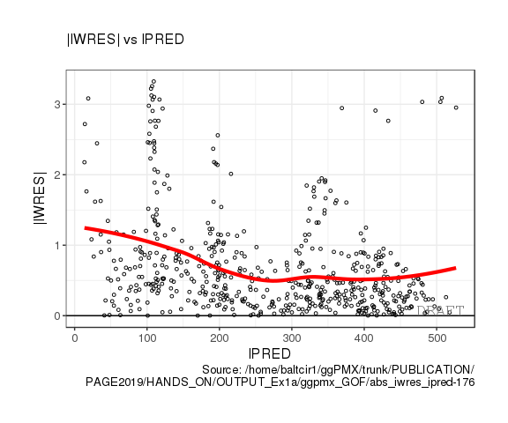
Residual-based diagnostics Individual Weighted Residual (IWRES)- inform about adequacy of individual predictions and correctness of the residual error model / check distributional assumptions

Slide 15
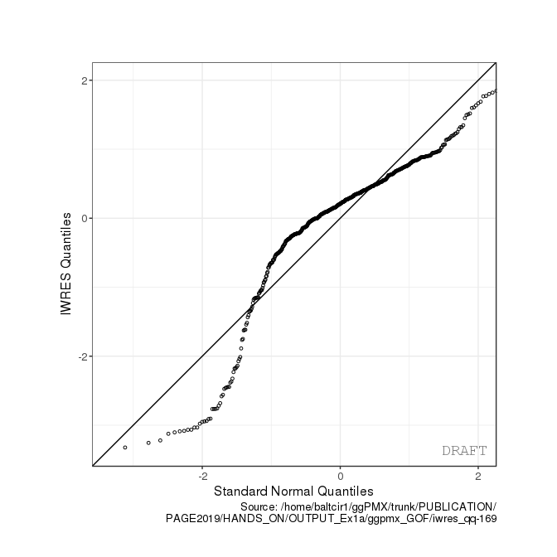
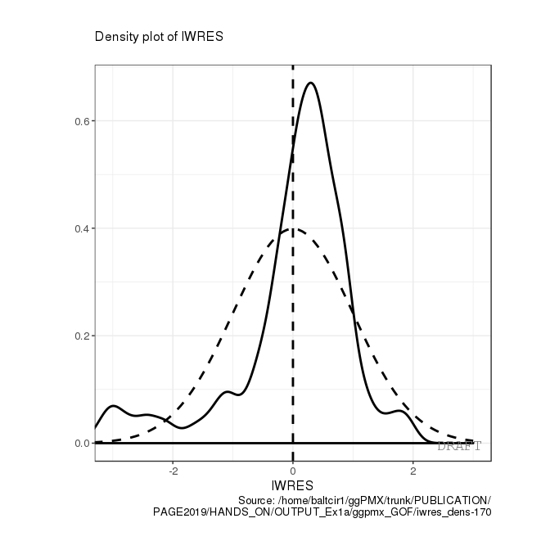
Residual-based diagnostics Individual Weighted Residual (IWRES)- inform about adequacy of individual predictions and correctness of the residual error model / check distributional assumptions

Slide 16
Residual-based diagnostics EBE-based Diagnostics - to assess the normality assumption and correlation structure of random effect / assess correctness of covariate relationship into model
Section of modeling report | Description | Novartis | HA
Main body | Plot of normalized prediction distribution errors versus population predictions (NPD vs. EPRED) | ✔ | ✔
 | Plot of normalized prediction discrepancies versus time (NPD vs. TIME) | ✔ | ✔
 | Plot of individual weighted residuals versus individual predictions (IWRES vs. IPRED) | ✔ | ✔
 | Plot of individual weighted residuals versus time (IWRES vs. TIME) | ✔ | ✔
 | Visual predictive check (VPC) | ✔ | ✔
Appendix | Distribution and quantile-quantile plot of IWRES | ✔ | ✔
 | Distribution and correlation structure of estimated inter-individual random effects (ETA) | ✔ | ✔
 | Relationships between estimated inter-individual random effects (ETA) and covariates | ✔ | ✔
 | Plots of observations and model predictions per individual | ✔ | ✔
 | Plot of observations versus population predictions (DV vs. EPRED) |  | ✔
 | Plot of observations versus individual predictions (DV vs. IPRED) |  | ✔
 | Plot of absolute individual weighted residuals versus individual predictions (|IWRES| vs. IPRED) |  | ✔

Slide 17
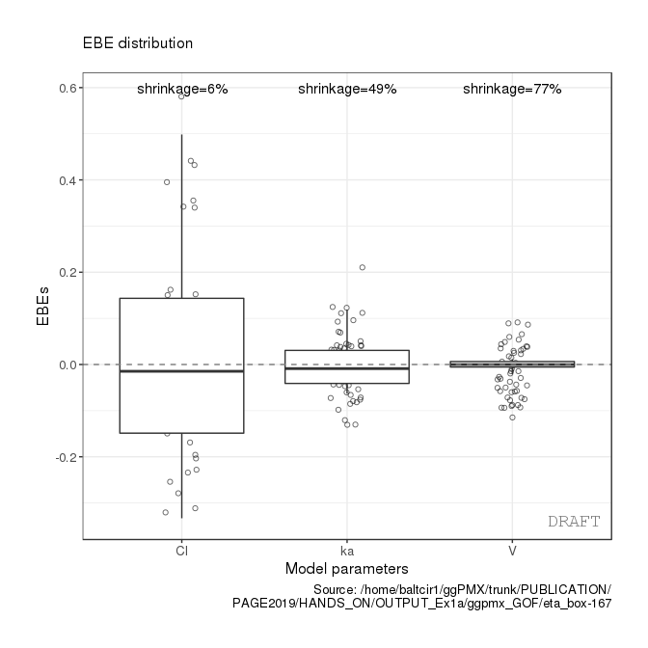
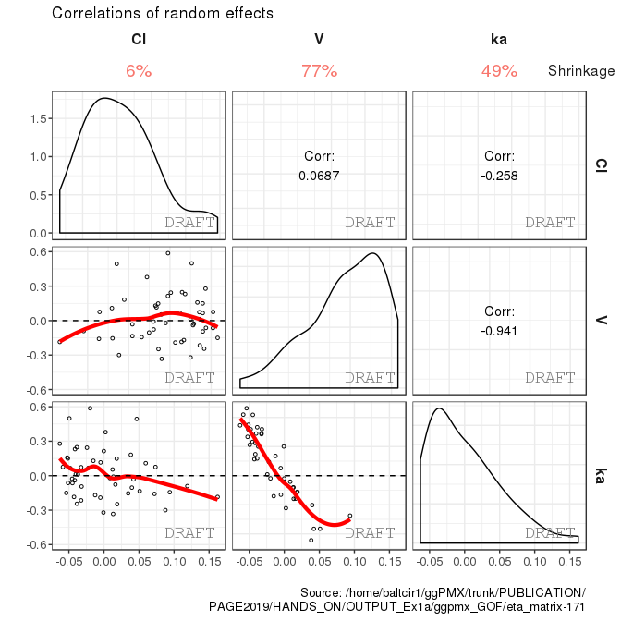
Residual-based diagnostics EBE-based Diagnostics - to assess the normality assumption and correlation structure of random effect / assess correctness of covariate relationship into model

Slide 18
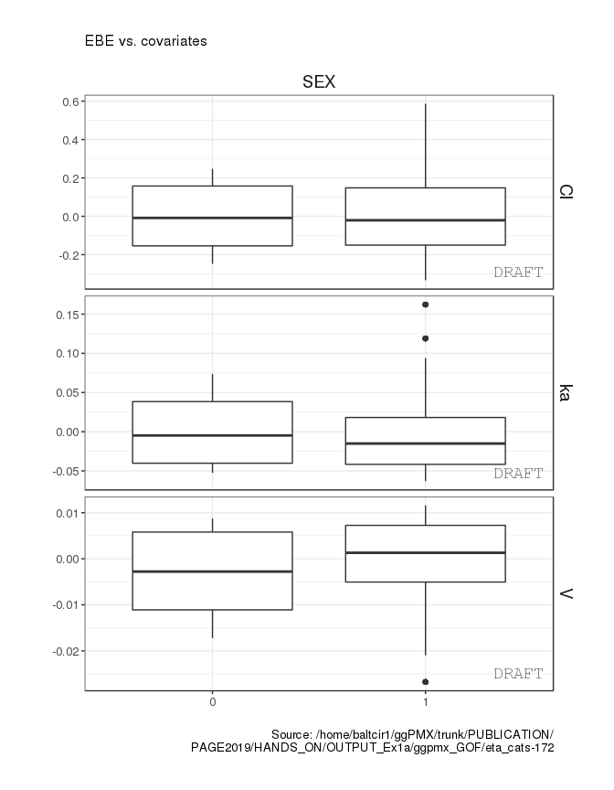
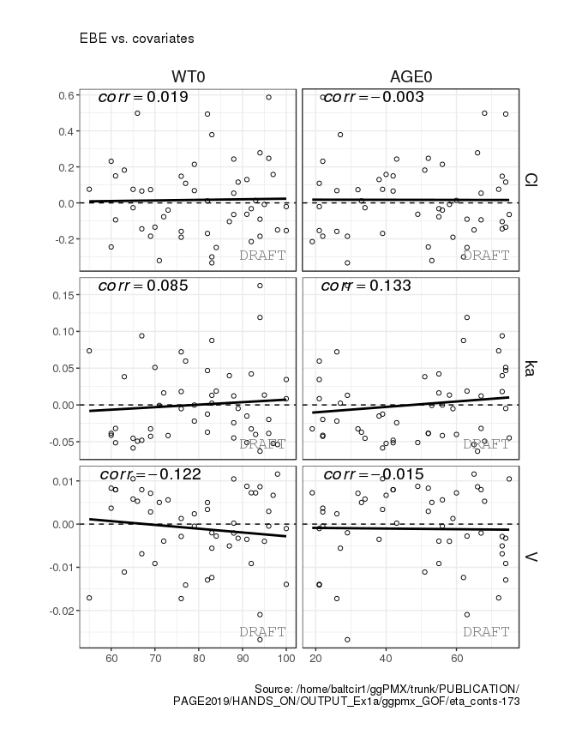
Residual-based diagnostics EBE-based Diagnostics - to assess the normality assumption and correlation structure of random effect / assess correctness of covariate relationship into model

Slide 19
Residual-based diagnostics Individual Fits – Quick glance at performance of the model to describe data
Section of modeling report | Description | Novartis | HA
Main body | Plot of normalized prediction distribution errors versus population predictions (NPD vs. EPRED) | ✔ | ✔
 | Plot of normalized prediction discrepancies versus time (NPD vs. TIME) | ✔ | ✔
 | Plot of individual weighted residuals versus individual predictions (IWRES vs. IPRED) | ✔ | ✔
 | Plot of individual weighted residuals versus time (IWRES vs. TIME) | ✔ | ✔
 | Visual predictive check (VPC) | ✔ | ✔
Appendix | Distribution and quantile-quantile plot of IWRES | ✔ | ✔
 | Distribution and correlation structure of estimated inter-individual random effects (ETA) | ✔ | ✔
 | Relationships between estimated inter-individual random effects (ETA) and covariates | ✔ | ✔
 | Plots of observations and model predictions per individual | ✔ | ✔
 | Plot of observations versus population predictions (DV vs. EPRED) |  | ✔
 | Plot of observations versus individual predictions (DV vs. IPRED) |  | ✔
 | Plot of absolute individual weighted residuals versus individual predictions (|IWRES| vs. IPRED) |  | ✔

Slide 20
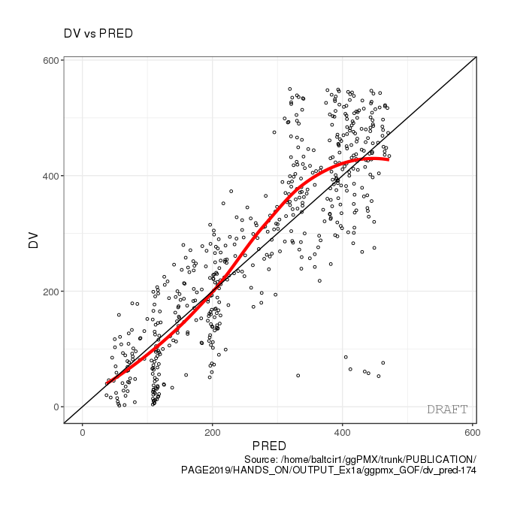
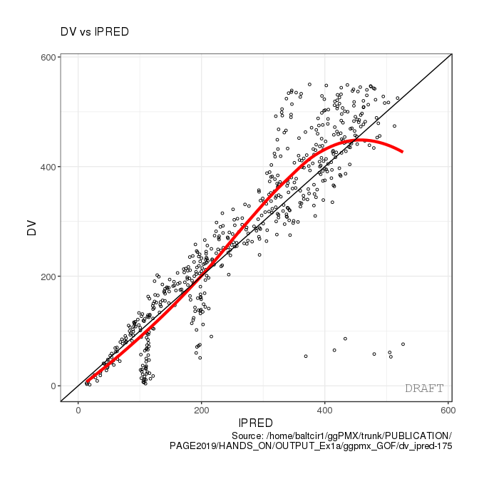
Residual-based diagnostics Individual Fits – Quick glance at performance of the model to describe data

Slide 21
Residual-based diagnostics Visual Predictive Check (VPC) – Inform about appropriateness of the structural model and the random-effects structure
Section of modeling report | Description | Novartis | HA
Main body | Plot of normalized prediction distribution errors versus population predictions (NPD vs. EPRED) | ✔ | ✔
 | Plot of normalized prediction discrepancies versus time (NPD vs. TIME) | ✔ | ✔
 | Plot of individual weighted residuals versus individual predictions (IWRES vs. IPRED) | ✔ | ✔
 | Plot of individual weighted residuals versus time (IWRES vs. TIME) | ✔ | ✔
 | Visual predictive check (VPC) | ✔ | ✔
Appendix | Distribution and quantile-quantile plot of IWRES | ✔ | ✔
 | Distribution and correlation structure of estimated inter-individual random effects (ETA) | ✔ | ✔
 | Relationships between estimated inter-individual random effects (ETA) and covariates | ✔ | ✔
 | Plots of observations and model predictions per individual | ✔ | ✔
 | Plot of observations versus population predictions (DV vs. EPRED) |  | ✔
 | Plot of observations versus individual predictions (DV vs. IPRED) |  | ✔
 | Plot of absolute individual weighted residuals versus individual predictions (|IWRES| vs. IPRED) |  | ✔

Slide 22
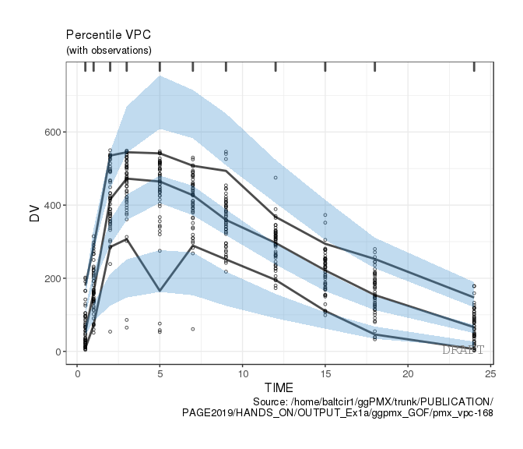
Residual-based diagnostics Visual Predictive Check (VPC) – Inform about appropriateness of the structural model and the random-effects structure

Slide 23
Key features
R Library of diagnostic plots for nonlinear mixed-effects model building and evaluation:
Consistent, reproducible and efficient workflow
High quality graphics, ready-to-use in submission documents and publications
Advanced Features for customization and stratification
Automated generation of PDF, Word or PNG outputs for reporting purpose

Slide 24
Automated Generation of Report

Slide 25
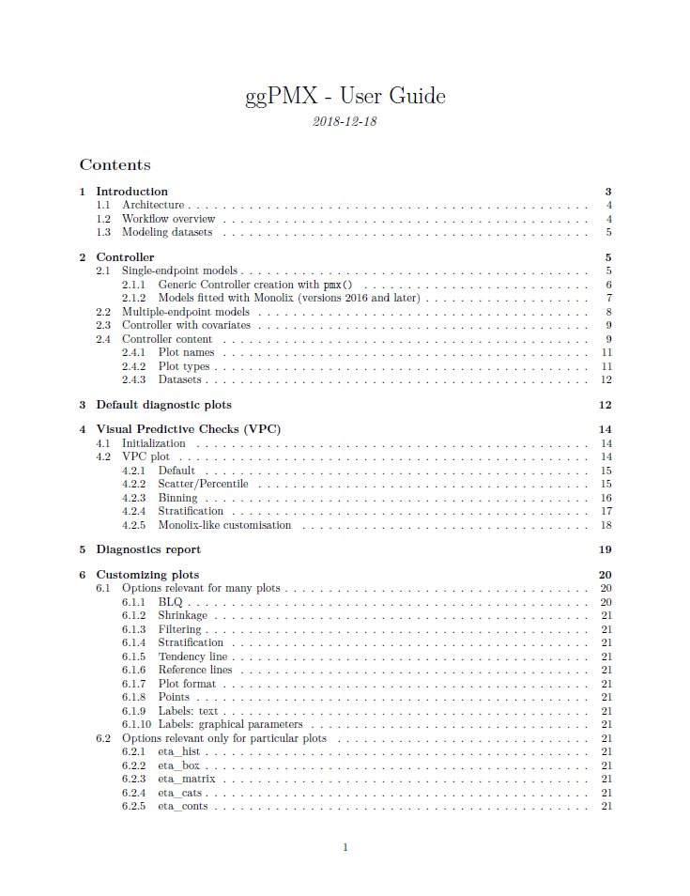
Documentation
Package available on CRAN
Documentation & Training Material on Github
https://github.com/ggPMXdevelopment/ggPMX
Cheat Sheet
Vignette (User Guide)

Slide 26
Overview
Introduction
Monolix requirements (tasks to perform)
Installation
Architecture
Built-in example and default plots
Report generation
Advanced Controller creation
Single endpoint models
Multiple endpoint models
Models with covariates
VPC (Visual Predictive Checks)
Plots customization
Stratification, filtering and other features
How to provide feedback?

Slide 27
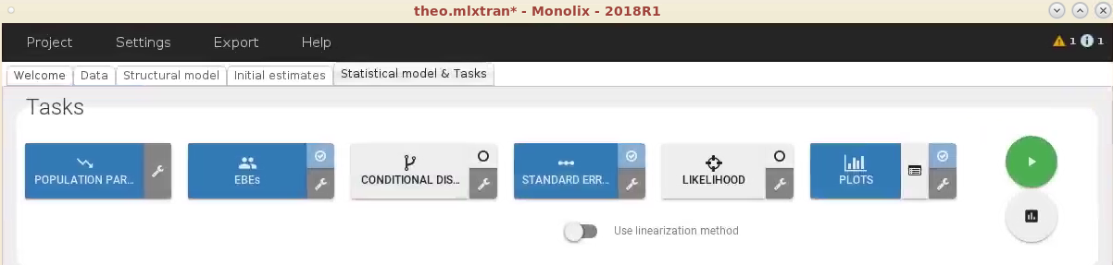
Monolix requirements to obtain all available diagnostic plots (1/3)
Monolix versions 2016 and later
Run at least the following Monolix tasks:
POPULATION PARAMETERS
EBEs
STANDARD ERRORS
PLOTS

Slide 28
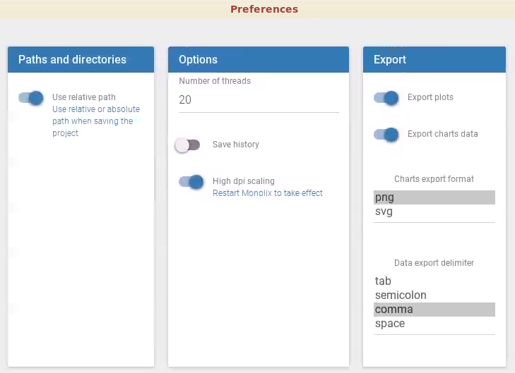
Monolix requirements to obtain all available diagnostic plots (2/3)
Make sure to export charts data
Settings -> Preferences -> Export -> switch on the Export charts data button

Slide 29
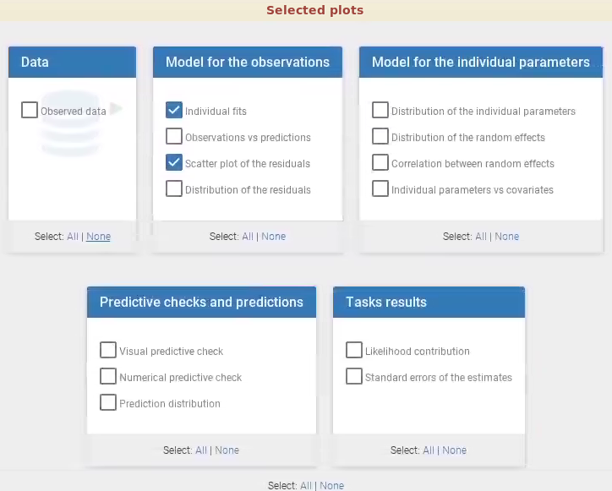
Monolix requirements to obtain all available diagnostic plots (3/3)
Select at least the following plots to be displayed and saved:
individual fits and
scatter plot of the residuals
If some Monolix output files are missing, ggPMX produces a warning and the corresponding plot won’t be available in the Controller.

Slide 30
Overview
Introduction
Monolix requirements (tasks to perform)
Installation
Architecture
Built-in example and default plots
Report generation
Advanced Controller creation
Single endpoint models
Multiple endpoint models
Models with covariates
VPC (Visual Predictive Checks)
Plots customization
Stratification, filtering and other features
How to provide feedback?

Slide 31
Installation
Open Rstudio
In Rstudio command line (or in your R script), type:
install.packages(“ggPMX”)
Verify that ggPMX has been included by typing:
sessionInfo()
Version should be 0.9.4

Slide 32
Overview
Introduction
Monolix requirements (tasks to perform)
Installation
Architecture
Built-in example and default plots
Report generation
Advanced Controller creation
Single endpoint models
Multiple endpoint models
Models with covariates
VPC (Visual Predictive Checks)
Plots customization
Stratification, filtering and other features
How to provide feedback?

Slide 33
Architecture
Object-oriented
Reader
reads model outputs from different softwares
restructures them into standard format for internal processing
Generator
processes outputs from Reader
produces the plots
configuration file defines the graphical options of the default plots.
Controller
serves as user interface.
The user will call Generator functions via wrapper functions in the Controller to produce either all the default plots or selected plots of interest.
User can edit the configuration and customize plots
Reporter
generates graphs and tables into an output file (Word or PDF) with annotations.

Slide 34
Overview
Introduction
Monolix requirements (tasks to perform)
Installation
Architecture
Built-in example and default plots
Report generation
Advanced Controller creation
Single endpoint models
Multiple endpoint models
Models with covariates
VPC (Visual Predictive Checks)
Plots customization
Stratification, filtering and other features
How to provide feedback?

Slide 35
Simple built-in example to explore the package: theophylline
PK model of theophylline is included in the package for demo purposes.
To load the example, type:
ctr = theophylline()
This will create a Controller called “ctr” (more explanations on Controller later on)
To view the plots and other Controller fields, type:
ctr

Slide 36
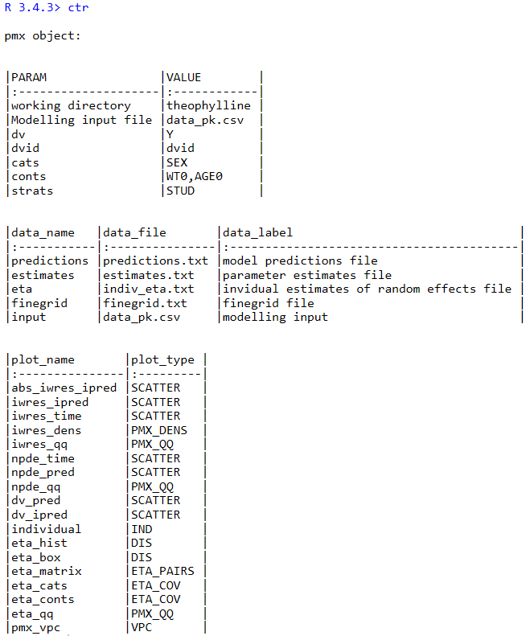
Controller content
Controller configuration
Monolix outputs
ggPMX datasets
Available plots
(command: pmx_plot_<plot_name>)

Slide 37
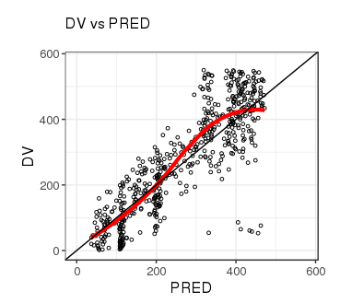
Default diagnostic plots
Plots visualized using the functions pmx_plot_xx(), where xx is a placeholder for the plot name. First argument is always the controller (use piping!)
List of plot names available by printing the controller or by calling the function plot_names()
Example:
ctr %>% pmx_plot_dv_pred
ctr %>% pmx_plot_npde_time
ctr %>% pmx_plot_eta_box
ctr %>% pmx_plot_eta_matrix
ctr %>% pmx_plot_individual
ctr %>% pmx_plot_vpc

Slide 38
Overview
Introduction
Monolix requirements (tasks to perform)
Installation
Architecture
Built-in example and default plots
Report generation
Advanced Controller creation
Single endpoint models
Multiple endpoint models
Models with covariates
VPC (Visual Predictive Checks)
Plots customization
Stratification, filtering and other features
How to provide feedback?

Slide 39
Report generation
A pdf or docx report is created using pmx_report()
Argument “format” can take 3 values:
“report”: produces name.pdf and name.docx, located in save_dir with default diagnostic plots
“plots”: produces a folder named ggpmx_GOF located in save_dir that contains all default diagnostic plots, each in a .pdf and .png file. Plots are numerated with an unique identifier (ex: ebe_box-1.pdf).
“both”: is a combination of the two options above
Argument “save_dir” is the folder where you want the report
theophylline = file.path(system.file(package = "ggPMX"), "testdata", "theophylline")
work_dir = file.path(theophylline, "Monolix")
ctr %>% pmx_report(name=’Diagnostic_plots2’,
save_dir = work_dir, format=’both’)

Slide 40
Editing the report template
The user can customize the default report by creating a “template”.
To create a template, do the following:
create a default report with the following command:
The resulting Rmarkdown file (Diagnostic_plots1.Rmd) is the “ new template”.
Modify Diagnostic_plots1.Rmd as desired (ex: change the size and settings of some figures) and save the modified file.
Create a report using the new template:
ctr %>% pmx_report(name=’Diagnostic_plots1’,
save_dir = work_dir, format=’both’)
ctr %>% pmx_report(name=’Diagnostic_plots3’,
save_dir = work_dir,
format=’report’,
template=file.path(work_dir,’Diagnostic_plots1.Rmd’))

Slide 41
Overview
Introduction
Monolix requirements (tasks to perform)
Installation
Architecture
Built-in example and default plots
Report generation
Advanced Controller creation
Single endpoint models
Multiple endpoint models
Models with covariates
VPC (Visual Predictive Checks)
Plots customization
Stratification, filtering and other features
How to provide feedback?

Slide 42
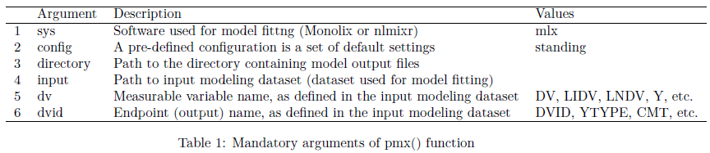
Advanced Controller creation -Single endpoint
The function pmx() is the generic function for creating a Controller.
theophylline_path = file.path(system.file(package = "ggPMX"), "testdata", "theophylline")
work_dir = file.path(theophylline_path, "Monolix")
input_data = file.path(theophylline_path, "data_pk.csv")
ctr = pmx(sys = "mlx", config = "standing",
directory = work_dir, input = input_data,
dv = "Y", dvid = "DVID")

Slide 43
Controller for single endpoint (2/2)
Parameter name | Meaning
sys | name of the software used for model fitting (“mlx”)
config | path to configuration file, name of configuration within the built-in list of configurations, or a configuration object
directory | path to directory containing fit results
input | path to modeling dataset (used for model fitting)
dv | name of column in modeling dataset that defines the dependent variable
id | name of column in modeling dataset that defines the subject identifier
time | name of column in modeling dataset that defines the independent (usually time) variable
dvid | name of column in modeling dataset that defines the identifier of the dependent variable (mandatory in case of multiple endpoint)
cats | vector of categorical covariates (as in modeling dataset)
conts | vector of categorical covariates (as in modeling dataset)
strats | vector of stratification variables (as in modeling dataset)
occ | name of dataset column for inter-occasion variability
settings | graphical settings shared by all plots
endpoint | defines the endpoint for which to display diagnostics
sim | user-provided simulations for VPC plot
bloq | defines settings of censored data
mandatory
character
optional
object

Slide 44
Models fitted with Monolix (versions 2016 and later)
Simplified controller creation: pmx_mlx() is a wrapper function for pmx() with sys = “mlx”.
Further simplification: pmx_mlxtran() parses the mlxtran file of a Monolix project and assigns automatically the fields. Only one mandatory argument: file_name, the path to the mlxtran file
ctr <- pmx_mlx(config = "standing",
directory = work_dir,
input = input_data,
dv = "Y",
dvid = "DVID")
mlxtran_path <- file.path(system.file(package = "ggPMX"),
"testdata", "1_popPK_model", "project.mlxtran")
ctr <- pmx_mlxtran(file_name = mlxtran_path)

Slide 45
Models with covariates
theophylline_path <- file.path(system.file(package = "ggPMX"), "testdata", "theophylline")
work_dir <- file.path(theophylline_path, "Monolix")
input_data <- file.path(theophylline_path, "data_pk.csv")
ctr <- pmx_mlx(config = "standing",
directory = work_dir,
input = input_data,
dv = "Y",
dvid = "DVID",
cats = c("SEX"),
conts = c("WT0", "AGE0"),
strats = c("STUD", "SEX")
)
Categorical covariates
Continuous covariates
categorical variables that can be used for plot stratification, but are not used as covariates in the model

Slide 46
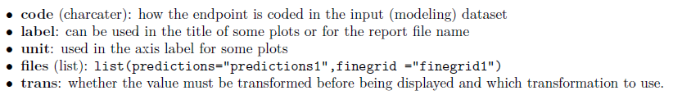
Multiple endpoint models (1/4)
ggPMX produces one diagnostics report per endpoint.
The endpoint is defined within the Controller:
to filter the observations dataset
to keep only the values corresponding to the endpoint of interest
The function pmx_endpoint() creates an “endpoint” object having the following attributes:

Slide 47
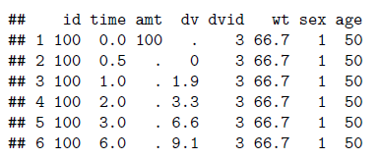
Multiple endpoints models (2/4)
Built-in PKPD example:
The dvid column of the input dataset pk_pd.csv contains values=3 for PK (first endpoint) and dose and =4 for PD (second endpoint).
pkpd_path <- file.path(system.file(package = "ggPMX"), "testdata", "pk_pd")
pkpd_work_dir <- file.path(pkpd_path, "RESULTS")
pkpd_input_file <- file.path(pkpd_path, "pk_pd.csv")

Slide 48
Multiple endpoints models (3/4)
Monolix2016 outputs are found in folder RESULTS/ which contains
predictions1.txt and finegrid1.txt for PK
predictions2.txt and finegrid2.txt for PD
ep <- pmx_endpoint(code = "4",
label = "some_label",
unit = "some_unit",
file.code = "2", # will use predictions2.txt and finegrig2.txt
trans = "log10")
ctr <- pmx_mlx(config = "standing",
directory = pkpd_work_dir,
input = pkpd_input_file,
dv = "dv",
dvid = "dvid",
endpoint = ep)
## use predictions2.txt as model predictions file .
## use finegrid2.txt as finegrid file .

Slide 49
Multiple endpoints models (4/4)
Simplified syntax for the Endpoint creation when the endpoint code matches the files post-fixes:
code=1 corresponds to predictions1.txt
code=2 corresponds to predictions2.txt
Instead of passing a pmx_endpoint object as argument of the Controller, specify the numerical value corresponding to the YTYPE/CMT/DVID column.
pmx_mlx(
dvid = "YTYPE", ## use this column as observation id
endpoint = 1, ## select the first endpoint
...) ## other pmx parameters , config, input,etc..

Slide 50
Overview
Introduction
Monolix requirements (tasks to perform)
Installation
Architecture
Built-in example and default plots
Report generation
Advanced Controller creation
Single endpoint models
Multiple endpoint models
Models with covariates
VPC (Visual Predictive Checks)
Plots customization
Stratification, filtering and other features
How to provide feedback?

Slide 51
VPC (1/5) – simulation dataset
User needs to provide a simulation file containing (at least) the following columns:
ID: individual identifiers
REP: simulation replicate number
TIME: time
DV: dependent variable
Use your preferred simulation software/package to create the simulation dataset (example code using simulix provided in back up)
Note: package classInt is used for binning

Slide 52
VPC (2/5) – Controller creation
To include the simulation dataset in ggPMX, create a “simulation object” using pmx_sim() and pass it as an argument to the Controller.
theoph_path <- file.path(system.file(package = "ggPMX"), "testdata","theophylline")
WORK_DIR <- file.path(theoph_path, "Monolix")
input_file <- file.path(theoph_path, "data_pk.csv")
vpc_file <- file.path(theoph_path, "sim.csv")
ctr <- pmx_mlx(config = "standing",
directory = WORK_DIR,
input = input_file,
dv = "Y",
cats = c("SEX"),
conts = c("WT0", "AGE0"),
strats = "STUD",
sim = pmx_sim(file = vpc_file, irun ="rep", idv="TIME"))

Slide 53
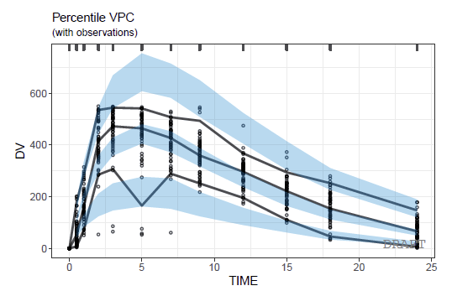
VPC (3/5) – the plot
ctr %>% pmx_plot_vpc
Are displayed :
5th, 50th and 95th percentiles
90% confidence intervals

Slide 54
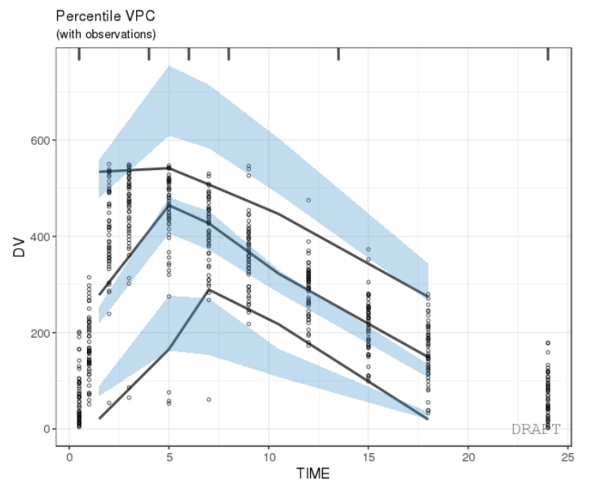
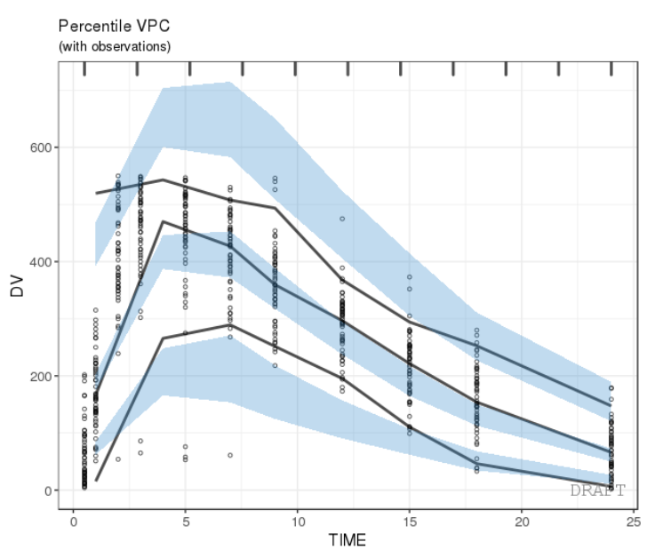
VPC (4/5) – change the bins
1.
2.
ctr %>% pmx_plot_vpc(bin=pmx_vpc_bin(style = "kmeans",n=5))
ctr %>% pmx_plot_vpc(bin=pmx_vpc_bin(style = “equal",n=10))
1.
2.

Slide 55
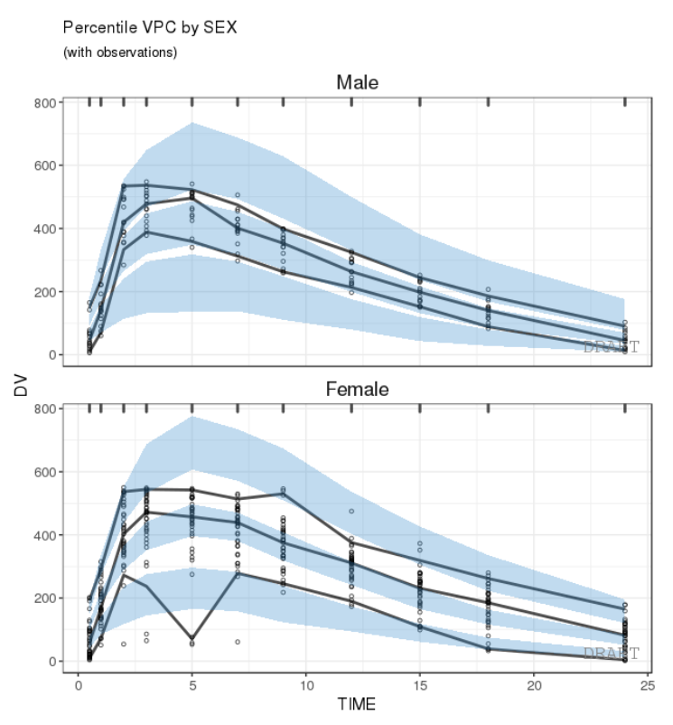
VPC (5/5) - stratification
ctr %>% pmx_plot_vpc(strat.facet="SEX",facets=list(nrow=2))

Slide 56
Overview
Introduction
Monolix requirements (tasks to perform)
Installation
Architecture
Built-in example and default plots
Report generation
Advanced Controller creation
Single endpoint models
Multiple endpoint models
Models with covariates
VPC (Visual Predictive Checks)
Plots customization
Stratification, filtering and other features
How to provide feedback?

Slide 57
Plots customization – two methods
On the fly (recommended), by specifying options in each function call
Globally, at the level of Controller creation, via settings argument

Slide 58
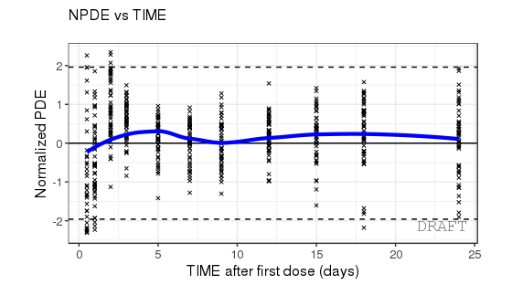
Plots customization – on the fly
ctr %>% pmx_plot_npde_time(
smooth = list(color = "blue"),
point = list(shape = 4),
is.draft = TRUE,
labels = list(x = "TIME after first dose (days)",
y = "Normalized PDE"))

Slide 59
Plots customization – globally
Create a “settings” object using pmx_settings(). This object is passed to pmx() as argument “settings”.
Using such a syntax is useful when same setting is applied to all plots, e.g.:
Remove DRAFT label (printed by default)
Use meaningful labels, such as “Male” and “Female” instead of 0 or 1.
Etc.
theoph_path <- file.path(system.file(package = "ggPMX"), "testdata", "theophylline")
WORK_DIR <- file.path(theoph_path, "Monolix")
input_file <- file.path(theoph_path, "data_pk.csv")
vpc_file <- file.path(theoph_path, "sim.csv")
my_settings = pmx_settings(use.labels = TRUE,
is.draft = FALSE,
cats.labels=list(SEX=c("0"="Male","1"="Female"),
STUD=c("1"="Study 1", "2"="Study 2")))
ctr <- pmx_mlx(config = "standing",
directory = WORK_DIR,
input = input_file,
dv = "Y",
cats = c("SEX"),
conts = c("WT0", "AGE0"),
strats = "STUD",
settings = my_settings,
sim = pmx_sim(file = vpc_file, irun ="rep", idv="TIME"))
Global settings

Slide 60
Overview
Introduction
Monolix requirements (tasks to perform)
Installation
Architecture
Built-in example and default plots
Report generation
Advanced Controller creation
Single endpoint models
Multiple endpoint models
Models with covariates
VPC (Visual Predictive Checks)
Plots customization
Stratification, filtering and other features
How to provide feedback?

Slide 61
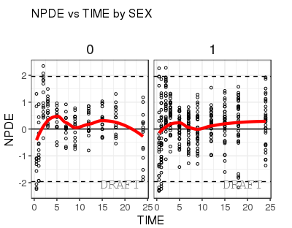
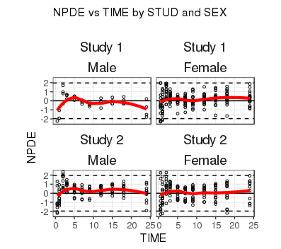
Stratification
Two ways of stratifying a plot:
1. using the stratification function by categorical covariates and providing the plot name in argument:
2. using arguments strat.facet (discrete) or strat.color (continuous) in pmx_plot_xxx(). Allows two-dimentional stratification:
pmx_plot_cats(ctr, "npde_time")
pmx_plot_npde_time(ctr,
strat.facet = STUD~SEX)

Slide 62
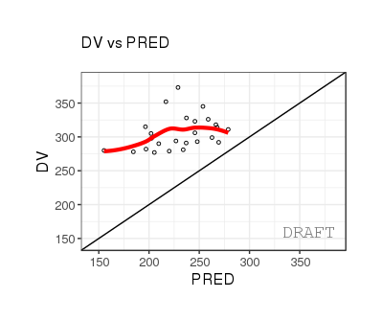
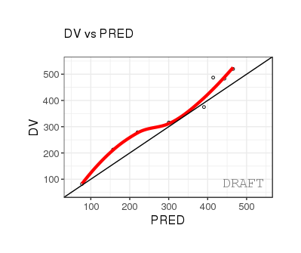
Filtering
Two ways of filtering the data:
Locally, at the level of a plot:
Globally, at the level of the Controller, affecting all subsequent plots:
ctr %>% pmx_plot_dv_pred(filter = DV > mean(DV) & PRED < median(PRED))
ctr %>% pmx_filter(data_set = "prediction",ID == 5 & TIME > 2)
ctr %>% pmx_plot_dv_pred

Slide 63
Other available features
More features are available in the package:
BLQ (see hands-on)
Shrinkage
For info on the above, see backup slides and/or read the vignette and the help.

Slide 64
Overview
Introduction
Monolix requirements (tasks to perform)
Installation
Architecture
Built-in example and default plots
Report generation
Advanced Controller creation
Single endpoint models
Multiple endpoint models
Models with covariates
VPC (Visual Predictive Checks)
Plots customization
Stratification, filtering and other features
How to provide feedback?

Slide 65
How to provide feedback?
If you find a bug or if you would like to suggest improvements, please submit a ticket on GitHub
https://github.com/ggPMXdevelopment/ggPMX
Fill-out the Gizmo Survey to provide your feedback on the workshop
https://www.surveygizmo.eu/s3/90150006/ggPMX-PAGE-Training-Survey

Slide 66
Acknowledgements
Amine Gassem
Christian Bartels
Thomas Dumortier
Souvik Bhattacharya
Inga Ludwig
Ines Paule
Didier Renard

Slide 67
Key features
R Library of diagnostic plots for nonlinear mixed-effects model building and evaluation:
Consistent, reproducible and efficient workflow
High quality graphics, ready-to-use in submission documents and publications
Advanced Features for customization and stratification
Automated generation of PDF, Word or PNG outputs for reporting purpose

Slide 69
Backup

Slide 70
Simulation code for VPC
## Library setting
library(dplyr)
library(mlxR)
setMlxLibraryPath("/CHBS/apps/Monolix/2018R1");
## Path and filename of the mlxtran project
myprojfilename <- '...../myprojfile.mlxtran'
## Path and filename of the to-be-created simulation file
mysimfilename <- '...../mysimfile.csv’
## NN - Create vpc file and store it
mysim <- simulx(project=myprojfilename,nrep=200)
write.csv(mysim$dv,file=mysimfilename,quote=F,row.names = F)
## Display the simulation file
## For each record in the input dataset (identified by id and time),
## there will be nrep (here, 200) simulations, identified by rep=1, 2, ..., nrep.
head(mysim)

Slide 71
BLQ
See hands-on

Slide 72
Shrinkage
The shrinkage is a computation within controller data. It might be used to annotate the plots. It can be generated directly from pmx_comp_shrink
ctr %>% pmx_comp_shrink
#> EFFECT OMEGA SHRINK POS
#> 1: Cl 0.22485 0.05793712 0.2934250
#> 2: V 0.03939 0.76978183 0.0057915
#> 3: ka 0.10024 0.49240546 0.0810850
User can remove shrinkage annotation using is.shrink option (TRUE in many pmx_plot_xx)
ctr %>% pmx_plot_eta_box( is.shrink = FALSE)

